Slide 1
Python Basics

Slide 2




Highlights
Example
Question
Notes
Coding Style

Slide 3

Roadmap
Introduction
Objects, Variables, and Data Types
Strings, List and Dictionary
Control Flow Statements

Slide 4

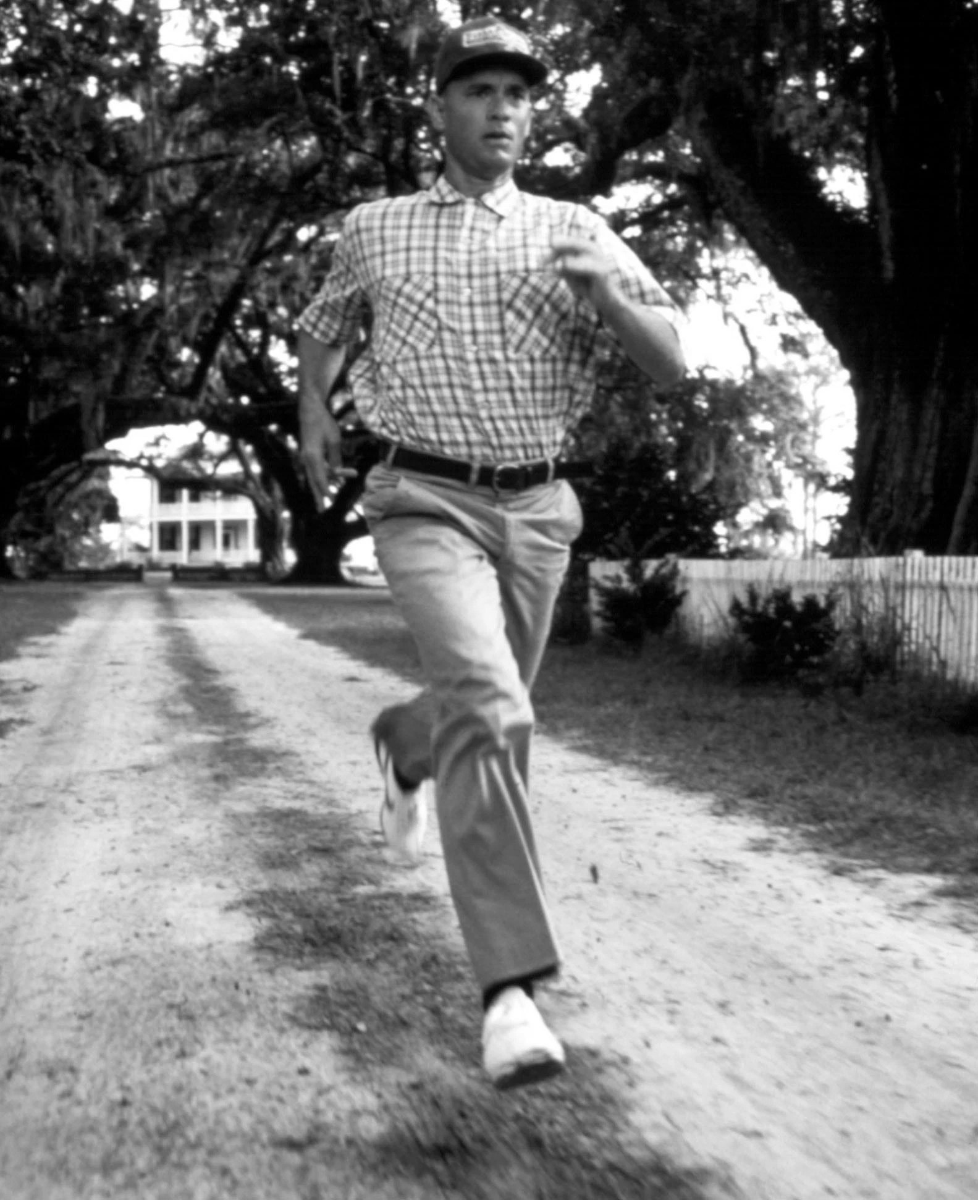
Run! Python, Run!
I just feel like running……
Python!

Slide 5



Run! Python, Run!
Installation
Python
Jupyter Notebook (Anaconda)
IDEs (Pycharm/Spyder)

Slide 6
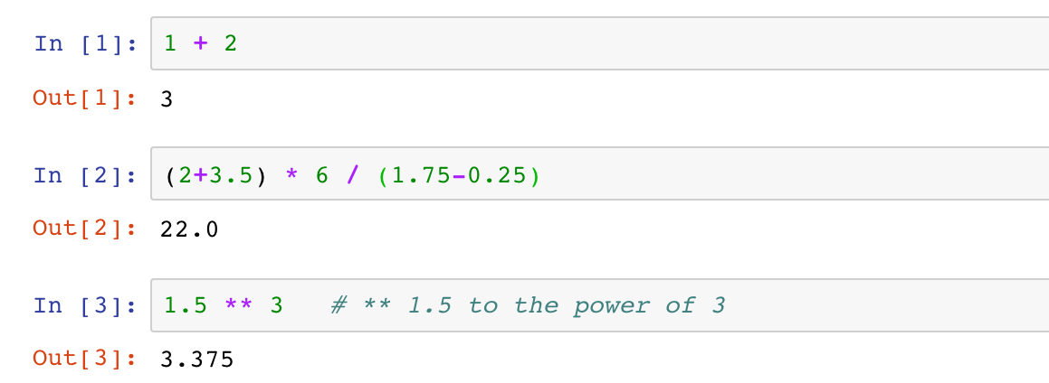
Run! Python, Run!
Interactive Shell Combining Code with Text
Try Python as a scientific calculator
Python arithmetic operators
Python code is executed line by line (cell by cell)

Slide 7


Run! Python, Run!
Interactive Shell Combining Code with Text
Try Python as a scientific calculator
Python arithmetic operators
Python code is executed line by line (cell by cell)
Notes
Splitting a statement into multiple lines is not allowed.

Slide 8

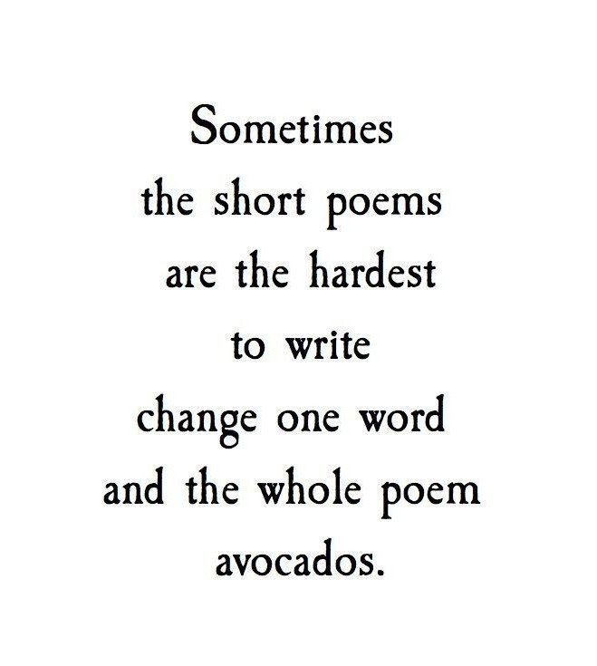
Run! Python, Run!
ith Text
ell by cell)
Interactive Shell Combining Code w
Try Python as a scientific calculator
Python arithmetic operators
Python code is executed line by line (c
Not allowed!!
Notes
Splitting a statement into multiple lines is not allowed.

Slide 9

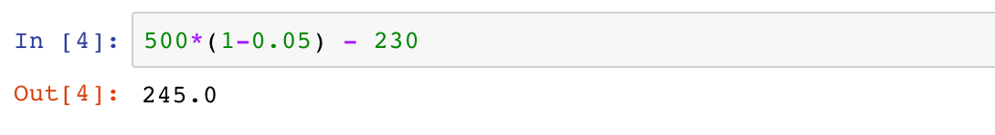
Run! Python, Run!
Interactive Shell Combining Code with Text
Try Python as a scientific calculator
Python arithmetic operators
Python code is executed line by line (cell by cell)
Example 1
A grocery store had 500 packs of cookies in storage. Among the total storage, 5% were dumped due to expiration, and another 230 packs were sold. Calculate how many packs of cookies are left in the grocery store.

Slide 10
Roadmap
Introduction
Objects, Variables, and Data Types
Strings, List and Dictionary
Control Flow Statements

Slide 11

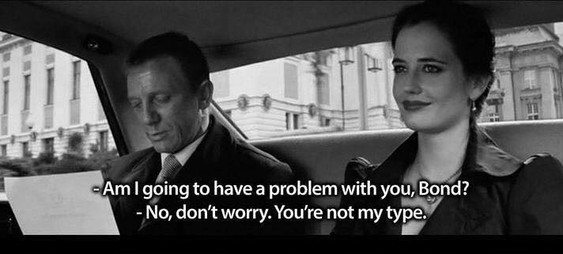
Objects, Variables, and Data Types

Slide 12
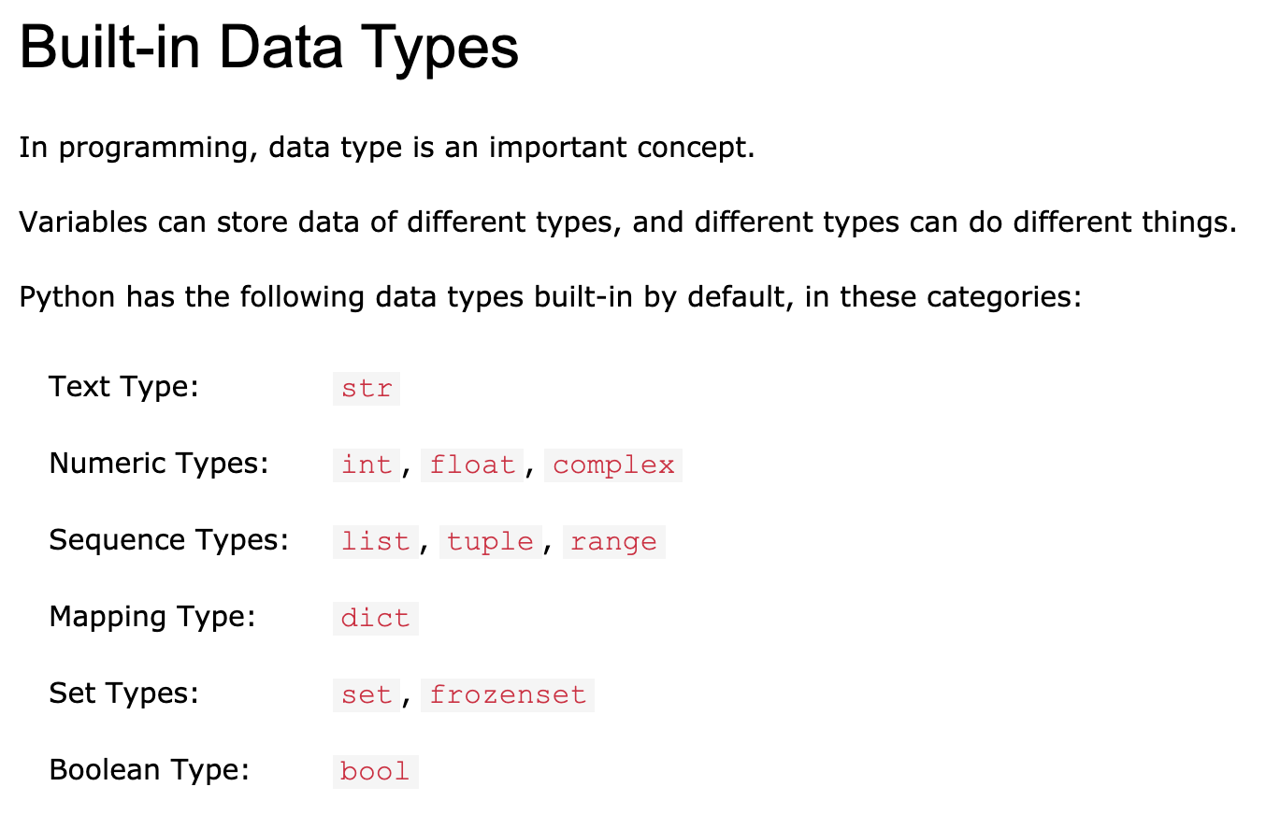
Objects, Variables, and Data Types
An Overview of Datatypes:
https://www.w3schools.com/python/python_datatypes.asp

Slide 13
Objects, Variables, and Data Types
Objects
Almost everything in Python is an object
Every object has a value and a type

Slide 14
Objects, Variables, and Data Types
Variables and Assignment Statements
Variables gives names to objects
Reuse the same value
Improve the readability
Enable control flow

Slide 15

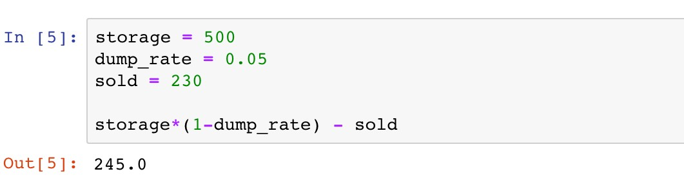
Objects, Variables, and Data Types
Variables and Assignment Statements
The value of a variable can be retrieved by invoking the name
Example 1
A grocery store had 500 packs of cookies in storage. Among the total storage, 5% were dumped due to expiration, and another 230 packs were sold. Calculate how many packs of cookies are left in the grocery store.

Slide 16
Objects, Variables, and Data Types
Variables and Assignment Statements
Assignment operator “="
Example 1
A grocery store had 500 packs of cookies in storage. Among the total storage, 5% were dumped due to expiration, and another 230 packs were sold. Calculate how many packs of cookies are left in the grocery store.

Slide 17
Objects, Variables, and Data Types
Variables and Assignment Statements
Variable(s): name(s) on the left
Example 1
A grocery store had 500 packs of cookies in storage. Among the total storage, 5% were dumped due to expiration, and another 230 packs were sold. Calculate how many packs of cookies are left in the grocery store.

Slide 18


Objects, Variables, and Data Types
Variables and Assignment Statements
Variable(s): name(s) on the left
Example 1
A grocery store had 500 packs of cookies in storage. Among the total storage, 5% were dumped due to expiration, and another 230 packs were sold. Calculate how many packs of cookies are left in the grocery store.
Notes
Only one “word”
Only consist of letters, numbers, and underscores
Cannot begin with a number
Avoid contradictions with Python keywords

Slide 19
Objects, Variables, and Data Types
Variables and Assignment Statements
Value(s): expression(s) on the right
Example 1
A grocery store had 500 packs of cookies in storage. Among the total storage, 5% were dumped due to expiration, and another 230 packs were sold. Calculate how many packs of cookies are left in the grocery store.

Slide 20
Objects, Variables, and Data Types
Variables and Assignment Statements
The value of a variable can be retrieved by invoking the name
Example 1
A grocery store had 500 packs of cookies in storage. Among the total storage, 5% were dumped due to expiration, and another 230 packs were sold. Calculate how many packs of cookies are left in the grocery store.

Slide 21


Objects, Variables, and Data Types
Variables and Assignment Statements
The value of a variable can be retrieved by invoking the name
Example 1
A grocery store had 500 packs of cookies in storage. Among the total storage, 5% were dumped due to expiration, and another 230 packs were sold. Calculate how many packs of cookies are left in the grocery store.
Coding Style
PEP 8 Style Guide:
Using empty lines for better readability

Slide 22
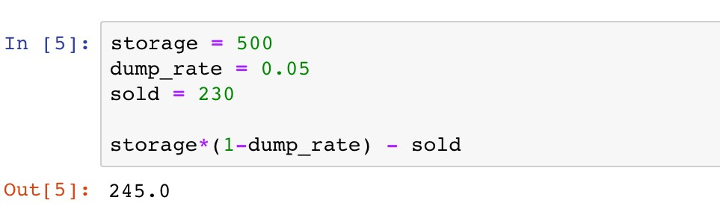
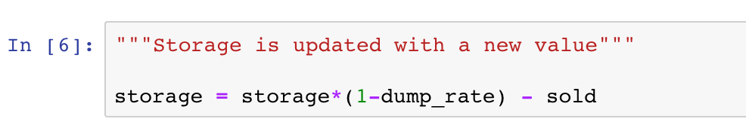
Objects, Variables, and Data Types
Variables and Assignment Statements
Assign new values to variables

Slide 23
Objects, Variables, and Data Types
Variables and Assignment Statements
Assign new values to variables

Slide 24
Objects, Variables, and Data Types
Variables and Assignment Statements
Assign new values to variables
500

Slide 25
Objects, Variables, and Data Types
Variables and Assignment Statements
Assign new values to variables
The new value 245 is assigned as the old one is forgotten

Slide 26


Objects, Variables, and Data Types
Variables and Assignment Statements
Assign new values to variables
Coding Style
PEP 8 Style Guide:
Function and variable names
Whitespace in expressions and statements

Slide 27

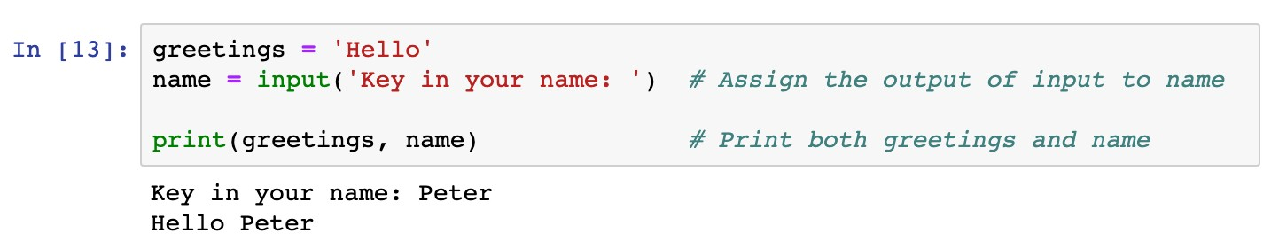
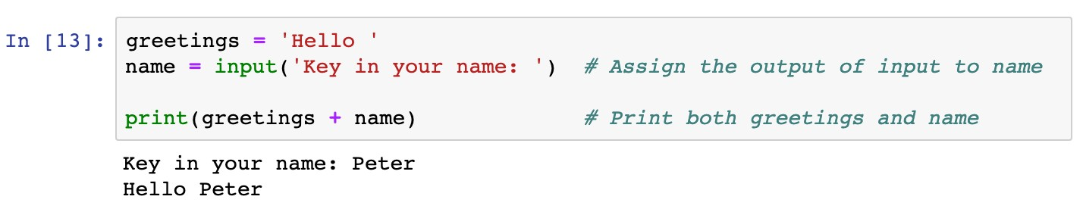
Objects, Variables, and Data Types
Variables and Assignment Statements
Assign values of function outputs to variables
Example 2
Use the “input” function in assignment statements

Slide 28
Objects, Variables, and Data Types
Variables and Assignment Statements
Assign values of function outputs to variables
Example 2
Use the “input” function in assignment statements
Functions: a block of organized, reusable code that is used to perform a single, related action

Slide 29
Objects, Variables, and Data Types
Variables and Assignment Statements
Assign values of function outputs to variables
Example 2
Use the “input” function in assignment statements

Slide 30
Objects, Variables, and Data Types
Variables and Assignment Statements
Assign values of function outputs to variables
Example 2
Use the “input” function in assignment statements
Output of the input function is the text given by users

Slide 31
Objects, Variables, and Data Types
Variables and Assignment Statements
Assign values of function outputs to variables
Example 2
Use the “input” function in assignment statements
Message displayed when users key in the text

Slide 32
Objects, Variables, and Data Types
Variables and Assignment Statements
Assign values of function outputs to variables
Example 2
Use the “input” function in assignment statements

Slide 33

Objects, Variables, and Data Types
Variables and Assignment Statements
Python vs Math
Question
Which assignment statement is correct?
x + y = 2
x * y = 1
2 = x
xy = 2
None of the above is correct

Slide 34
Objects, Variables, and Data Types
Variables and Assignment Statements
Other assignment operations
Operators
Remarks
Examples
+=
Equivalent to x Equivalent to x | = = | x x | + - | y y | x x | += -= | y y
Equivalent to x | = | x | * | y | x | *= | y
Equivalent to x | = | x | / | y | x | /= | y
-=
*=
/=
**=
Equivalent to x
= x**y
x **= y

Slide 35
Objects, Variables, and Data Types
Basic Built-in Data Types
Various types of data may be diﬀerent in nature
Data types determine how functions and operators work
Data types can be retrieved by function
type()

Slide 36
Objects, Variables, and Data Types
Basic Built-in Data Types
Numeric types
: signed integers
int
✓
float
: floating point real numbers
✓
long
and
complex:
long integers and complex numbers (not
covered in this course)

Slide 37
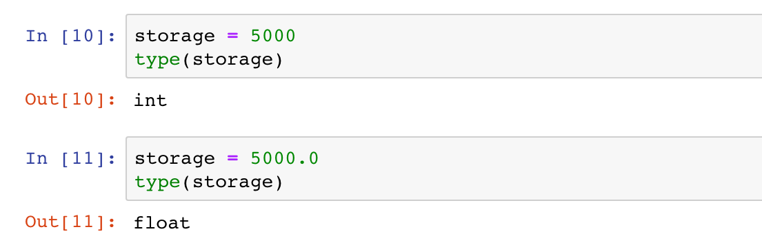
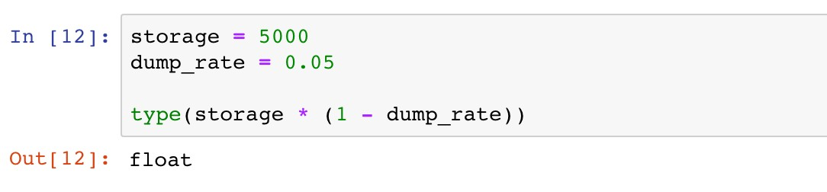
Objects, Variables, and Data Types
Basic Built-in Data Types
Numeric types

Slide 38
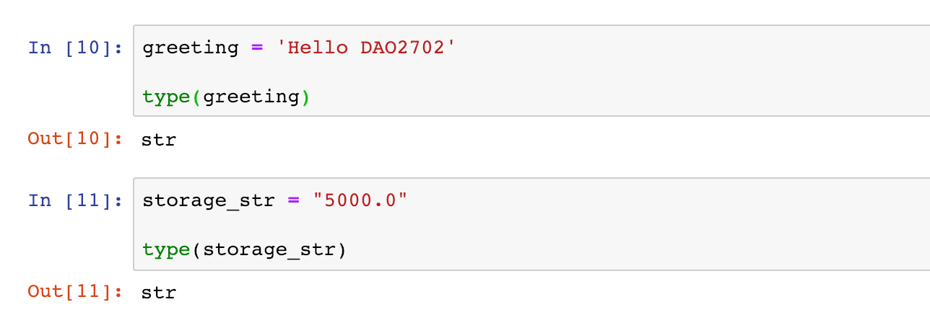
Objects, Variables, and Data Types
Basic Built-in Data Types
String:
str
Single or double quotation marks used in defining strings
Operators and can be used to manipulate strings
+
*

Slide 39
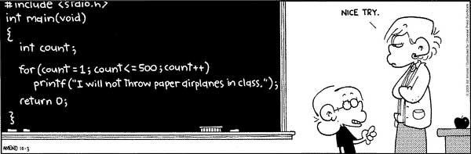
Objects, Variables, and Data Types
Basic Built-in Data Types
String:
str
Single or double quotation marks used in defining strings
Operators and can be used to manipulate strings
+
*
*
I QUIT TEACHING YOU …

Slide 40

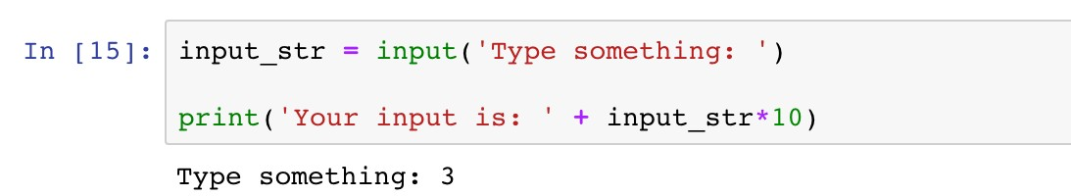
Objects, Variables, and Data Types
Basic Built-in Data Types
String:
str
Example 3
The function “input” enables users to type in a string of characters. Print a message “You input is:”, followed by the input string repeated ten times.

Slide 41
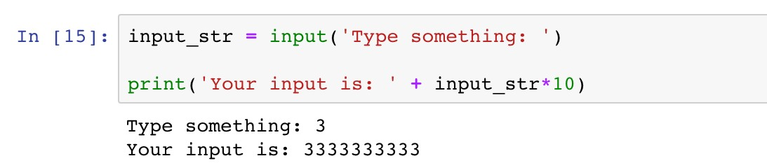
Objects, Variables, and Data Types
Basic Built-in Data Types
String:
str
Example 3
The function “input” enables users to type in a string of characters. Print a message “You input is:”, followed by the input string repeated ten times.
input_str is a string, so “+” combines strings, and “*” replicates strings.

Slide 42

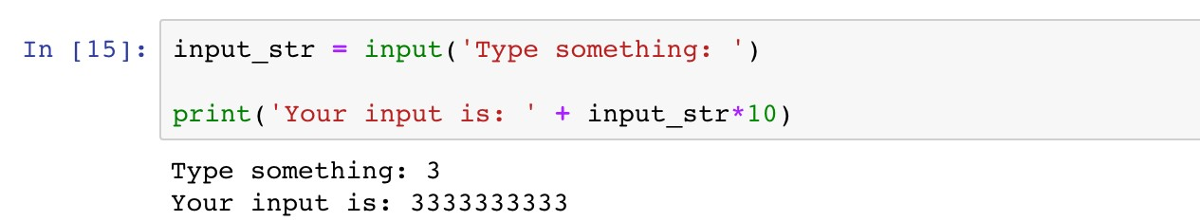
Objects, Variables, and Data Types
Basic Built-in Data Types
String:
str
HOW ABOUT MULTIPLYING THE INPUT NUMBER BY TEN?

Slide 43

Objects, Variables, and Data Types
Data Type Conversion
Enable manipulating data diﬀerently
Use type name as the conversion function
DATA TYPE CONVERSION!!

Slide 44
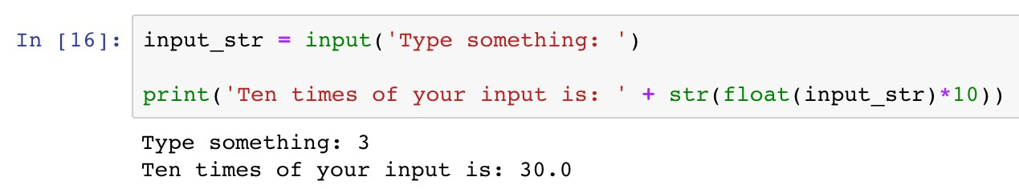
Objects, Variables, and Data Types
Data Type Conversion
Enable manipulating data diﬀerently
Use type name as the conversion function
DATA TYPE CONVERSION!!

Slide 45
Objects, Variables, and Data Types
Data Type Conversion
Enable manipulating data diﬀerently
Use type name as the conversion function
DATA TYPE CONVERSION!!
Convert the string to a floating point number

Slide 46
Objects, Variables, and Data Types
Data Type Conversion
Enable manipulating data diﬀerently
Use type name as the conversion function
DATA TYPE CONVERSION!!
Convert the floating point number back to a string

Slide 47

Objects, Variables, and Data Types
Data Type Conversion
BEFORE TYPE CONVERSION

Slide 48

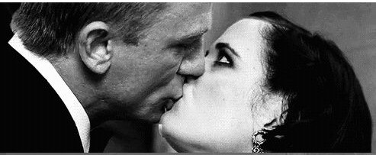
Objects, Variables, and Data Types
Data Type Conversion
BEFORE TYPE CONVERSION
AFTER TYPE CONVERSION

Slide 49

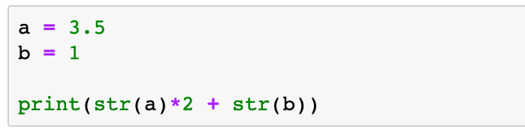
Objects, Variables, and Data Types
Data Type Conversion
Question
What is the output message of the following code?
A. 8
B. 3.53.51
C. 71
D. 3.53.51.0

Slide 50
Roadmap
Introduction
Objects, Variables, and Data Types
Strings, List and Dictionary
Control Flow Statements

Slide 51
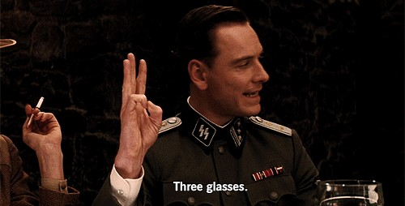
Strings
—“Three glasses” in Inglourious Basterds

Slide 52
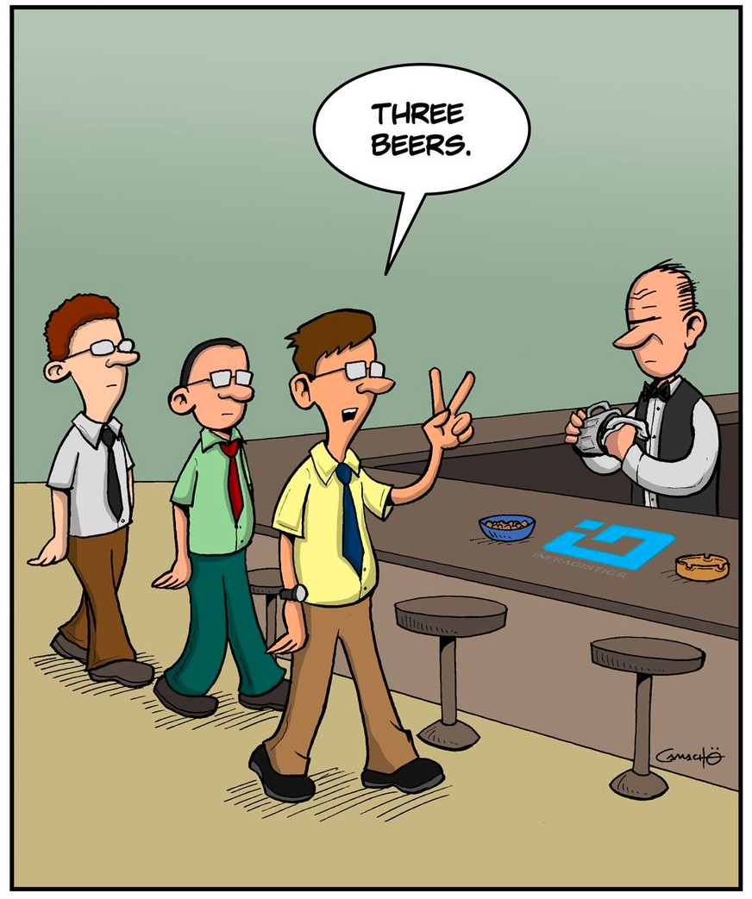
Strings
—“Three glasses” for Python programmers

Slide 53
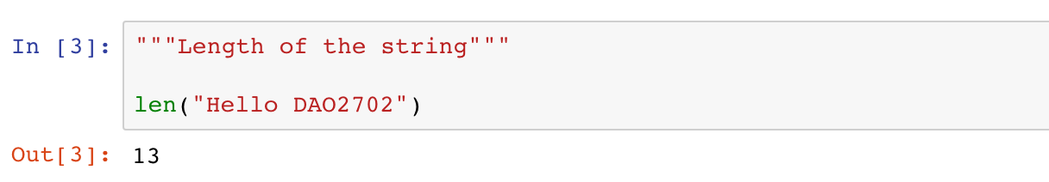
Strings
Strings are collections of characters
Length of a string (the number of characters)
13 characters
H | e | l | l | o |  | D | A | O | 2 | 7 | 0 | 2
0 1 2 3 4 5 6 7 8 9 10 11 12
-13 -12 -11 -10 -9 -8 -7 -6 -5 -4 -3 -2 -1

Slide 54
Strings
Strings are collections of characters
Accessing individual characters
13 characters
H | e | l | l | o |  | D | A | O | 2 | 7 | 0 | 2
0 1 2 3 4 5 6 7 8 9 10 11 12
-13 -12 -11 -10 -9 -8 -7 -6 -5 -4 -3 -2 -1

Slide 55
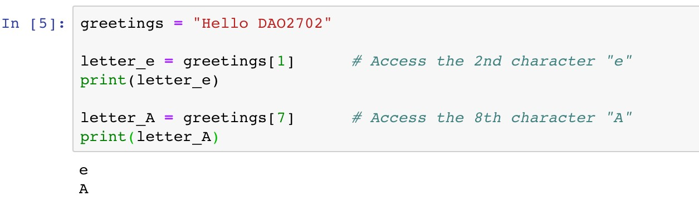
Strings
Strings are collections of characters
Accessing individual characters
13 characters
H |  | l | l | o |  | D |  | O | 2 | 7 | 0 | 2
0 |  | 2 | 3 | 4 | 5 | 6 |  | 8 | 9 | 10 | 11 | 12
e 1
A 7
Index
-13 -12 -11 -10 -9 -8 -7 -6 -5 -4 -3 -2 -1

Slide 56
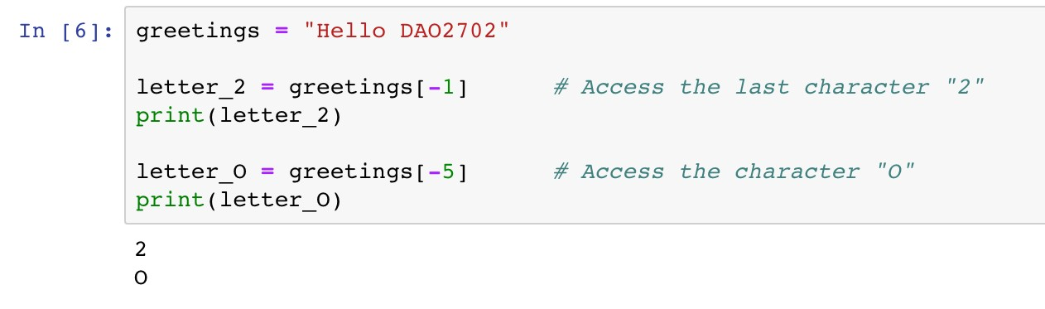
Strings
Strings are collections of characters
Accessing individual characters
13 characters
H | e | l | l | o |  | D | A |  | 2 | 7 | 0
0 | 1 | 2 | 3 | 4 | 5 | 6 | 7 |  | 9 | 10 | 11
-13 | -12 | -11 | -10 | -9 | -8 | -7 | -6 |  | -4 | -3 | -2
O 8
-5
2
12
-1
Index Index from rear

Slide 57
Strings
Strings are collections of characters
Slicing expression: access a subset of a string
13 characters
 |  | D | A | O | 2 | 7 | 0 | 2
 | 5 | 6 | 7 | 8 | 9 | 10 | 11 | 12
 | -8 | -7 | -6 | -5 | -4 | -3 | -2 | -1
H e l l o 0 1 2 3 4
-13 -12 -11 -10 -9
Index Index from rear

Slide 58
Strings
Strings are collections of characters
Slicing expression: access a subset of a string
[start:stop:step]
Arguments | Remarks | Default Values
start | The first index of the slice | 0
stop | The index before which the slice stops | Length of the string
step | The step length of the slice | 1

Slide 59
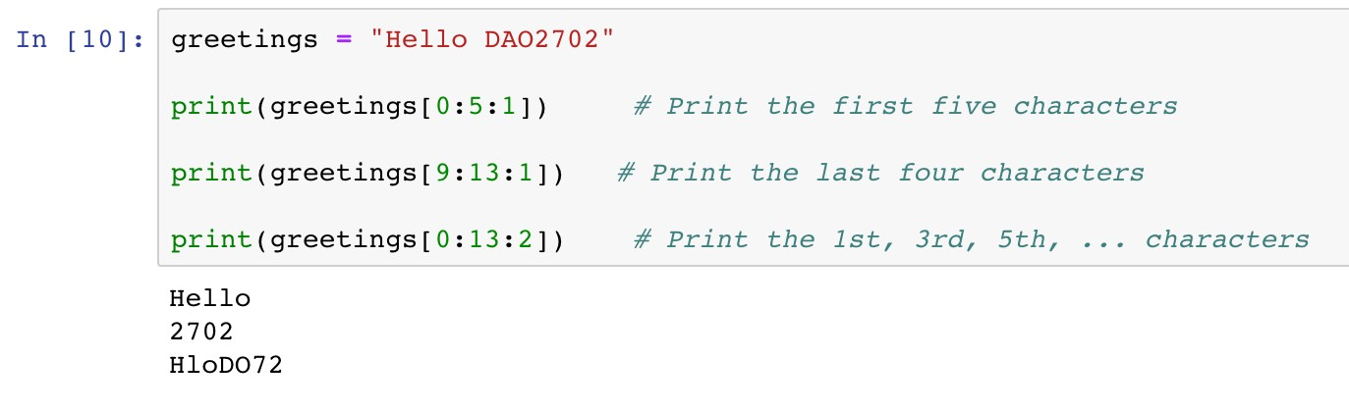
Strings
Strings are collections of characters
Slicing expression: access a subset of a string
13 characters
Index
 |  | D | A | O | 2 | 7 | 0 | 2
 | 5 | 6 | 7 | 8 | 9 | 10 | 11 | 12
H e l l o 0 1 2 3 4
-13 -12 -11 -10 -9 -8 -7 -6 -5 -4 -3 -2 -1
start
stop

Slide 60
Strings
Strings are collections of characters
Slicing expression: access a subset of a string
13 characters
Index
H | e | l | l | o |  | D | A | O
0 | 1 | 2 | 3 | 4 | 5 | 6 | 7 | 8
2 7 0 2
9 10 11 12
-13 -12 -11 -10 -9 -8 -7 -6 -5 -4 -3 -2 -1
start
stop

Slide 61
Strings
Strings are collections of characters
Slicing expression: access a subset of a string
13 characters
Index
 | e |  | l |  |  |  | A |  | 2 |  | 0
 | 1 |  | 3 |  | 5 |  | 7 |  | 9 |  | 11
H 0
l 2
o 4
D 6
O 8
7
10
2
12
-13 -12 -11 -10 -9 -8 -7 -6 -5 -4 -3 -2 -1
start
stop
step

Slide 62
Strings
Strings are collections of characters
Slicing expression
Arguments
Default Values
start 0
Unspecified
stop
Length of the string
step 1
[0:5:1]
[0:5:1]
[:5]
13 characters
Index
 |  | D | A | O | 2 | 7 | 0 | 2
 | 5 | 6 | 7 | 8 | 9 | 10 | 11 | 12
H e l l o 0 1 2 3 4
-13 -12 -11 -10 -9 -8 -7 -6 -5 -4 -3 -2 -1
start
stop

Slide 63

Strings
Strings are collections of characters
Slicing expression
Arguments
Default Values
start
0
Unspecified
stop Length of the string
step 1
[9:13:1]
[9:13:1]
[9:]
[-4:13:1]
[-4:13:1]
[-4:]
13 characters
Index Index from rear
H | e | l | l | o |  | D | A | O
0 | 1 | 2 | 3 | 4 | 5 | 6 | 7 | 8
-13 | -12 | -11 | -10 | -9 | -8 | -7 | -6 | -5
2 7 0 2
9 10 11 12
-4 -3 -2 -1
start
stop

Slide 64
Strings
Strings are collections of characters
Slicing expression
Arguments Default Values
step 1
start 0
Unspecified
stop Length of the string
[0:13:2]
[0:13:2]
[::2]
13 characters
Index
 | e |  | l |  |  |  | A |  | 2 |  | 0
 | 1 |  | 3 |  | 5 |  | 7 |  | 9 |  | 11
H 0
l 2
o 4
D 6
O 8
7
10
2
12
-13 -12 -11 -10 -9 -8 -7 -6 -5 -4 -3 -2 -1
start
stop
step

Slide 65

Strings
Strings are collections of characters
Slicing expression: access a subset of a string
Notes
A common mistake is assuming that the last index of the slice is stop. Please be very careful that the last index should be the last available integer before stop.

Slide 66
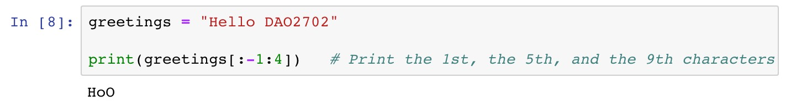
Strings
Strings are collections of characters
Slicing expression: access a subset of a string
13 characters
Index Index from rear
 | e | l | l |  |  | D | A |  | 2 | 7 | 0 | 2
 | 1 | 2 | 3 |  | 5 | 6 | 7 |  | 9 | 10 | 11 | 12
 | -12 | -11 | -10 |  | -8 | -7 | -6 |  | -4 | -3 | -2 | -1
H 0
-13
o 4
-9
O 8
-5
start
stop
step

Slide 67

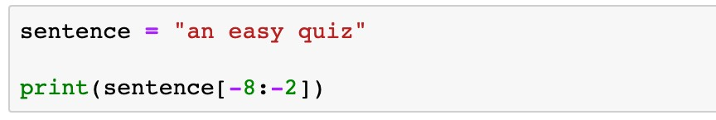
Strings
Strings are collections of characters
Indexing and slicing expression
Question
What is the printed message of the following code?
easy q
easy
asy qu
asy qui

Slide 68
Strings
Strings are collections of characters
Iterate characters via
range
✓
range
is a built-in data type that defines a sequence of integers
It is used in the form of
range(start, stop, step)
Arguments | Remarks | Default Values
start | The first index of the integer sequence | 0
stop | The index before which the sequence stops | -
step | The step length of the integer sequence | 1

Slide 69
Strings
Strings are collections of characters
Iterate characters via
range
✓
range
is a built-in data type that defines a sequence of integers
It is used in the form of
Examples
range(start, stop, step)
range(0, | 5, | 1) | 0, | 1, | 2, | 3, | 4
range(0, | 3) |  | 0, | 1, | 2
range(6) |  |  | 0, | 1, | 2, | 3, | 4, | 5

Slide 70
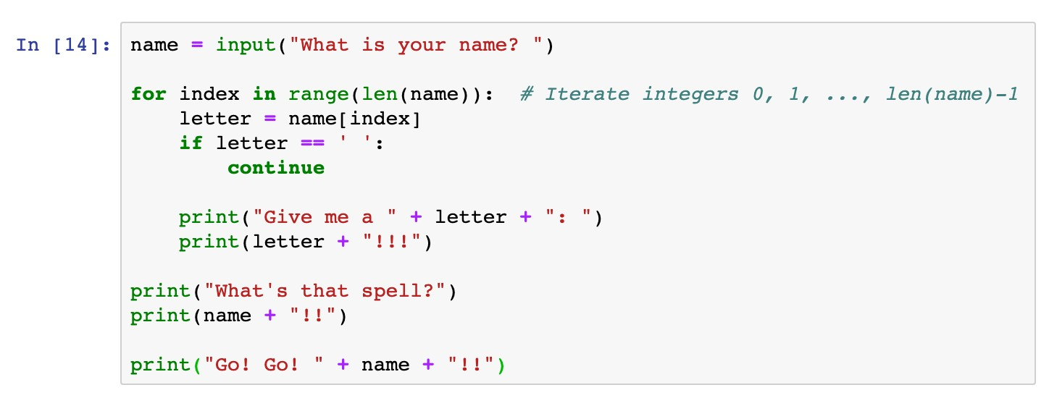
Strings
Strings are collections of characters
Iterate characters via
range
Use
range
as the index of characters

Slide 71
Strings
Strings are collections of characters
Iterate characters via
range
Use
range
as the index of characters
name range(len(name))
J | a | c | k
0 | 1 | 2 | 3

Slide 72
Strings
Strings are collections of characters
Iterate characters via
range
Use
range
as the index of characters
name[index]
1st iteration
J
name range(len(name))
J | a | c | k
0 | 1 | 2 | 3
1st iteration
index
0

Slide 73
Strings
Strings are collections of characters
Iterate characters via
range
Use
range
as the index of characters
name[index]
a
2nd iteration
name
range(len(name))
2nd iteration
J | a | c | k
0 | 1 | 2 | 3
index
1

Slide 74
Strings
Strings are collections of characters
Iterate characters via
range
Use
range
as the index of characters
name[index]
3rd iteration
c
name range(len(name))
J | a | c | k
0 | 1 | 2 | 3
3rd iteration
index
2

Slide 75
Strings
Strings are collections of characters
Iterate characters via
range
Use
range
as the index of characters
name[index]
4th iteration
k
name range(len(name))
J | a | c | k
0 | 1 | 2 | 3
4th iteration
index
3

Slide 76
Strings
Methods of strings
A method is a special function associated with an object
A method is called via the syntax
<object>.<method>(
)

Slide 77
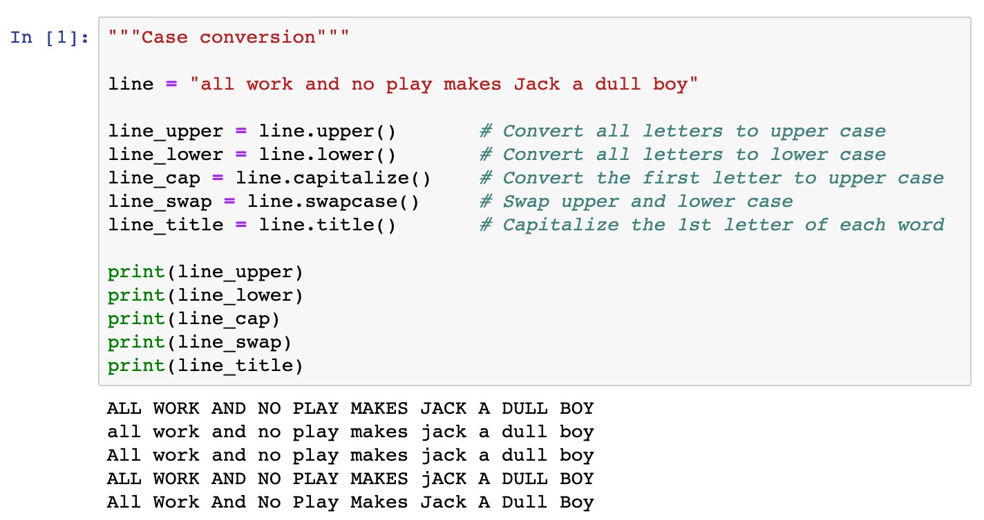
Strings
Methods of strings
Case conversion

Slide 78
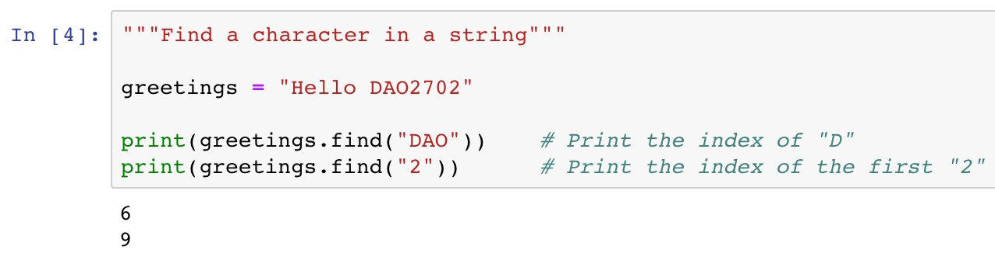
Strings
Methods of strings
Search items in a string
13 characters
H | e | l | l | o |  | D | A | O | 2 | 7 | 0 | 2
0 | 1 | 2 | 3 | 4 | 5 | 6 | 7 | 8 | 9 | 10 | 11 | 12
-13 -12 -11 -10 -9 -8 -7 -6 -5 -4 -3 -2 -1

Slide 79
Strings
Methods of strings
Search items in a string
This method returns -1 if the given item cannot be found
13 characters
H | e | l | l | o |  | D | A | O | 2 | 7 | 0 | 2
0 | 1 | 2 | 3 | 4 | 5 | 6 | 7 | 8 | 9 | 10 | 11 | 12
-13 -12 -11 -10 -9 -8 -7 -6 -5 -4 -3 -2 -1

Slide 80



Strings
Example 4
Write a program to print the initials of a name given by the user. For example, if the given name is "John Fitzgerald Kennedy", the printed out message is "JFK".
How would you do this logically and
write out steps without
using programming?

Slide 81


Strings
Example 4
Write a program to print the initials of a name given by the user. For example, if the given name is "John Fitzgerald Kennedy",the printed out message is "JFK".
In [17]: name = input ("Key in a name: ")
initials = name[O ] while True :
index = name .find (' ')
if index == -1: break
initials = initials + name[index+l ] name = name[index+l :]
# Get the first name initial
# Position of the first space
# Break if no space found
# Add the letter after space
# Get a subset of name
print (initials)
Key in a name: John Fitzgerald Kennedy JFK

Slide 82
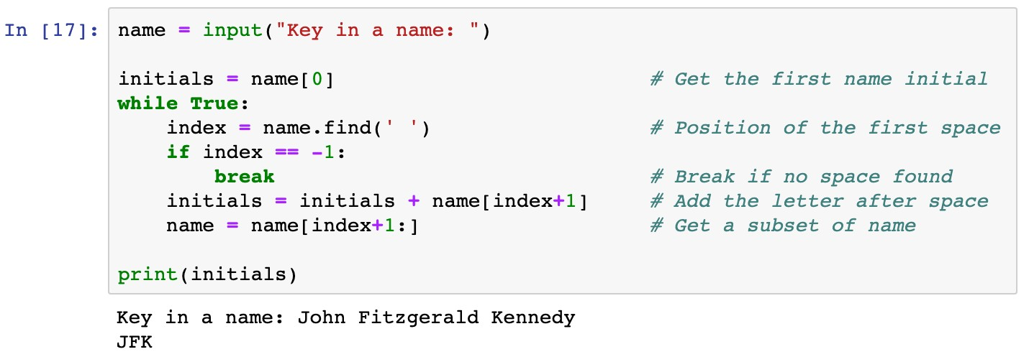
Strings
 | o | h | n |  | F | i | t | z | g | e | r | l | d |  | K | e | n | n | e | d | y
 | 1 | 2 | 3 | 4 | 5 | 6 | 7 | 8 | 9 | 10 | 11 | 12 | 13 | 14 | 15 | 16 | 17 | 18 | 19 | 20 | 21
name
J 0
initials
J
0

Slide 83
Strings
J | o | h | n |  | F | i | t | z | g | e | r | l | d |  | K | e | n | n | e | d | y
0 | 1 | 2 | 3 |  | 5 | 6 | 7 | 8 | 9 | 10 | 11 | 12 | 13 | 14 | 15 | 16 | 17 | 18 | 19 | 20 | 21
name
4
index
initials
J
0

Slide 84
Strings
F 5
name
name[index+1]
initials
J | o | h | n |  |  | i | t | z | g | e | r | l | d |  | K | e | n | n | e | d | y
0 | 1 | 2 | 3 | 4 |  | 6 | 7 | 8 | 9 | 10 | 11 | 12 | 13 | 14 | 15 | 16 | 17 | 18 | 19 | 20 | 21
J | F
0 | 1

Slide 85
Strings
Selects the remaining portion
J | o | h | n
0 | 1 | 2 | 3 | 4
name
F i t z g e r l d K e n n e d y 5 6 7 8 9 10 11 12 13 14 15 16 17 18 19 20 21
index
initials
J | F
0 | 1

Slide 86
Strings
name
F | i | t | z | g | e | r | l | d |  | K | e | n | n | e | d | y
0 | 1 | 2 | 3 | 4 | 5 | 6 | 7 | 8 | 9 | 10 | 11 | 12 | 13 | 14 | 15 | 16
initials
J | F
0 | 1

Slide 87
Strings
F | i | t | z | g | e | r | l | d |  | K | e | n | n | e | d | y
0 | 1 | 2 | 3 | 4 | 5 | 6 | 7 | 8 |  | 10 | 11 | 12 | 13 | 14 | 15 | 16
name
9
index
initials
J | F
0 | 1

Slide 88
Strings
F | i | t | z | g | e | r | l | d |  |  | e | n | n | e | d | y
0 | 1 | 2 | 3 | 4 | 5 | 6 | 7 | 8 | 9 |  | 11 | 12 | 13 | 14 | 15 | 16
name
K 10
name[index+1]
initials
J | F | K
0 | 1 | 2

Slide 89
Strings
F | i | t | z | g | e | r | l | d
0 | 1 | 2 | 3 | 4 | 5 | 6 | 7 | 8 | 9
name
K e n n e d y 10 11 12 13 14 15 16
index
initials
J | F | K
0 | 1 | 2

Slide 90
Strings
https://www.w3schools.com/python/ref_string_find.asp
name
K | e | n | n | e | d | y
0 | 1 | 2 | 3 | 4 | 5 | 6
-1
Cannot find a whitespace in name, so return -1
index
initials
J | F | K
0 | 1 | 2

Slide 91
Strings
name
K | e | n | n | e | d | y
0 | 1 | 2 | 3 | 4 | 5 | 6
-1
Cannot find a whitespace in name, so return -1
index
initials
J | F | K
0 | 1 | 2

Slide 92
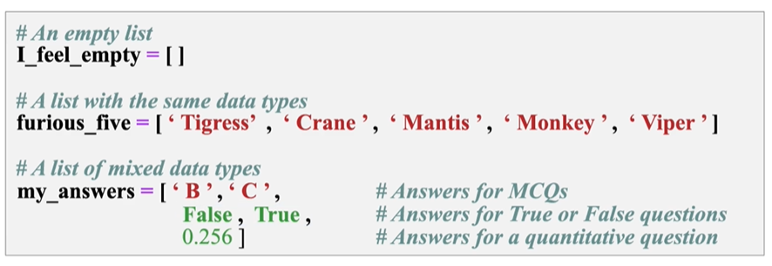
List
List
a collection which is ordered and changeable. Allows duplicate members
0 1 2 3 4 5 6 7 8 9 10 11 12
-13 -12 -11 -10 -9 -8 -7 -6 -5 -4 -3 -2 -1

Slide 93
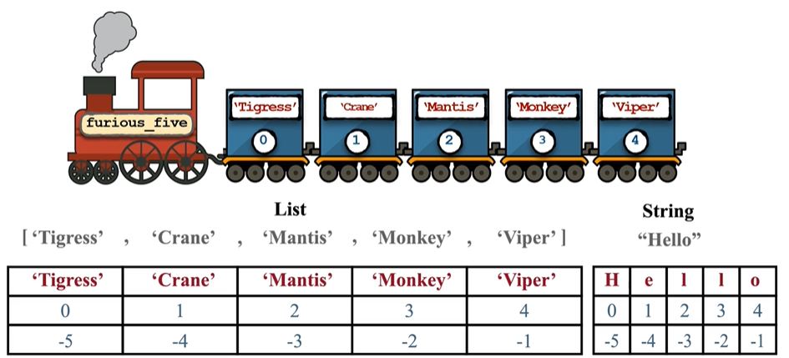
Similarities between list and strings
Similarity: Indexing and slicing
0 1 2 3 4 5 6 7 8 9 10 11 12
-13 -12 -11 -10 -9 -8 -7 -6 -5 -4 -3 -2 -1

Slide 94
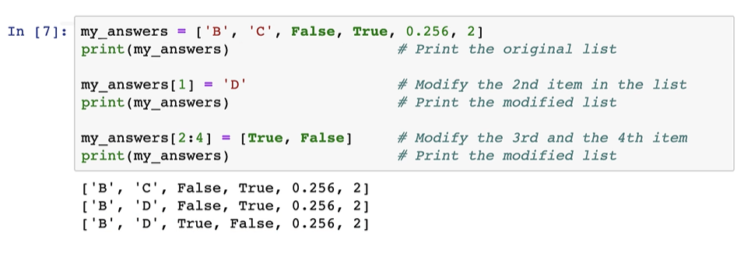
Differences between list and strings
Mutability: element-wise segment
If you try to change some characters in a string via indexing and slicing, an error message will be given!
0 1 2 3 4 5 6 7 8 9 10 11 12
-13 -12 -11 -10 -9 -8 -7 -6 -5 -4 -3 -2 -1

Slide 95
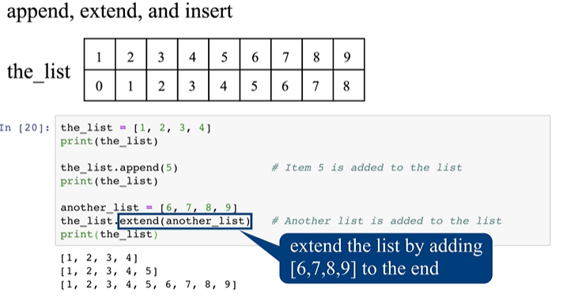
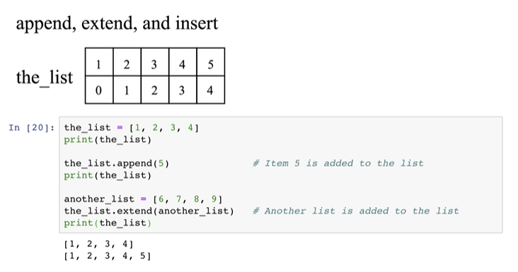
List methods
List
Append, extend a list
0 1 2 3 4 5 6 7 8 9 10 11 12
-13 -12 -11 -10 -9 -8 -7 -6 -5 -4 -3 -2 -1

Slide 96
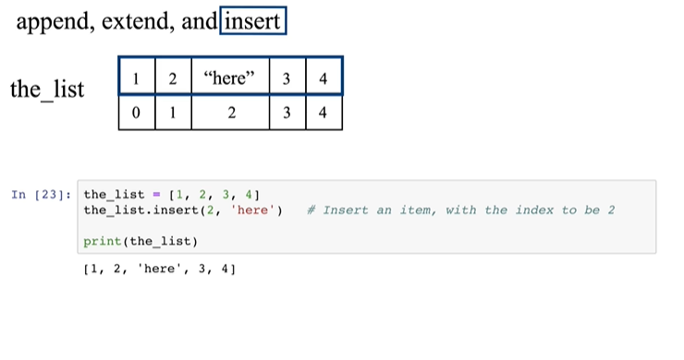
List methods
List
Insert an element to a list
0 1 2 3 4 5 6 7 8 9 10 11 12
-13 -12 -11 -10 -9 -8 -7 -6 -5 -4 -3 -2 -1

Slide 97
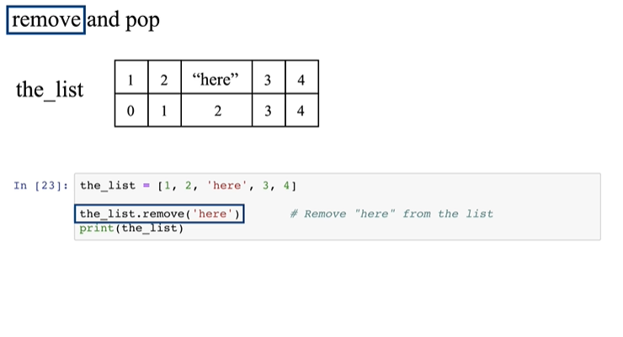
List methods
List
Remove an element from the list using remove()
0 1 2 3 4 5 6 7 8 9 10 11 12
-13 -12 -11 -10 -9 -8 -7 -6 -5 -4 -3 -2 -1

Slide 98
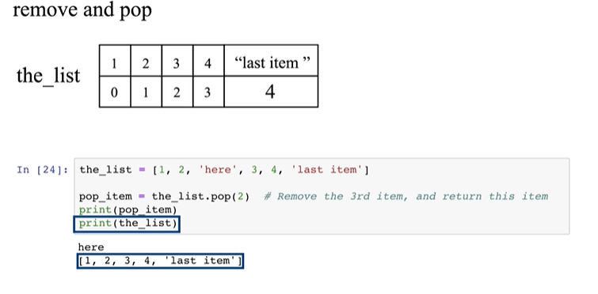
List methods
List
Remove an element from the list using pop()
0 1 2 3 4 5 6 7 8 9 10 11 12
-13 -12 -11 -10 -9 -8 -7 -6 -5 -4 -3 -2 -1

Slide 99
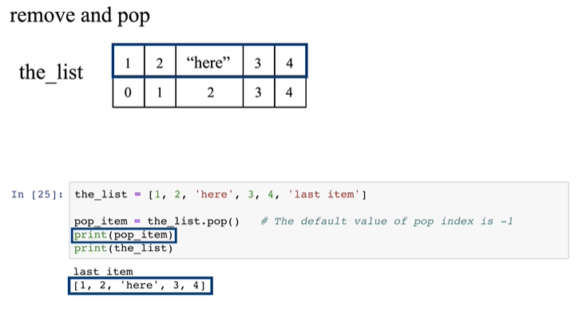
List methods
List
Remove an element from the list using pop()
0 1 2 3 4 5 6 7 8 9 10 11 12
-13 -12 -11 -10 -9 -8 -7 -6 -5 -4 -3 -2 -1

Slide 100
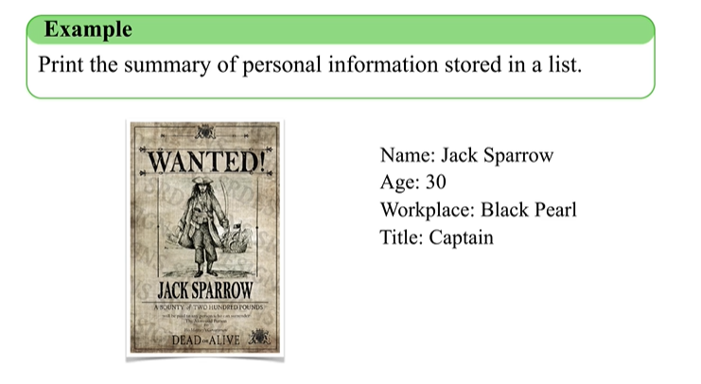
Dictionary
Dictionary
0 1 2 3 4 5 6 7 8 9 10 11 12
-13 -12 -11 -10 -9 -8 -7 -6 -5 -4 -3 -2 -1

Slide 101
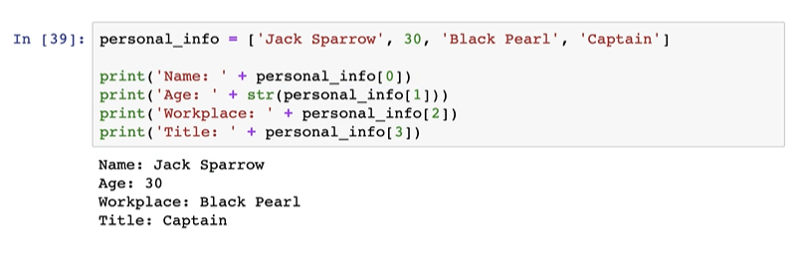
Dictionary
Dictionary
Is this a good method?
0 1 2 3 4 5 6 7 8 9 10 11 12
-13 -12 -11 -10 -9 -8 -7 -6 -5 -4 -3 -2 -1

Slide 102
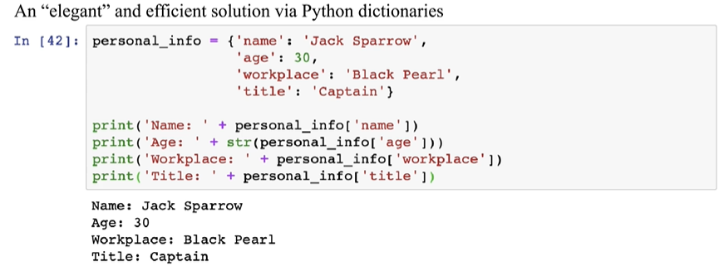
Dictionary
Dictionary
0 1 2 3 4 5 6 7 8 9 10 11 12
-13 -12 -11 -10 -9 -8 -7 -6 -5 -4 -3 -2 -1

Slide 103
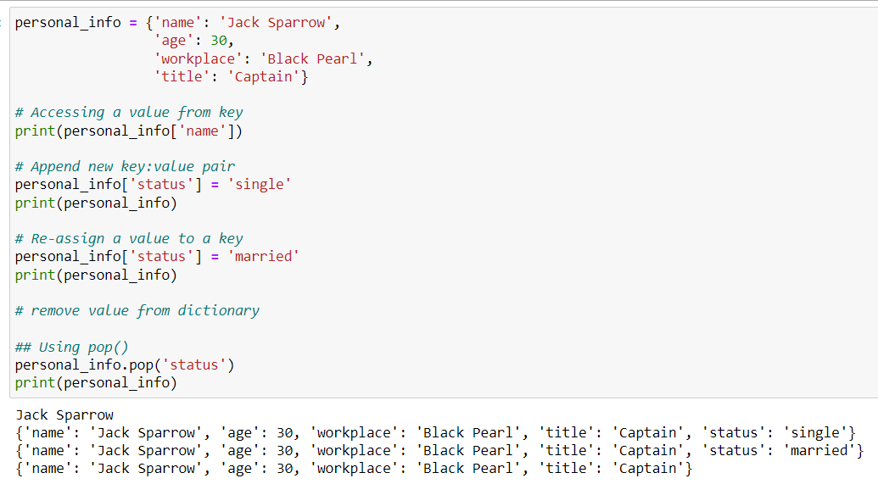
Dictionary
Dictionary
0 1 2 3 4 5 6 7 8 9 10 11 12
-13 -12 -11 -10 -9 -8 -7 -6 -5 -4 -3 -2 -1

Slide 104
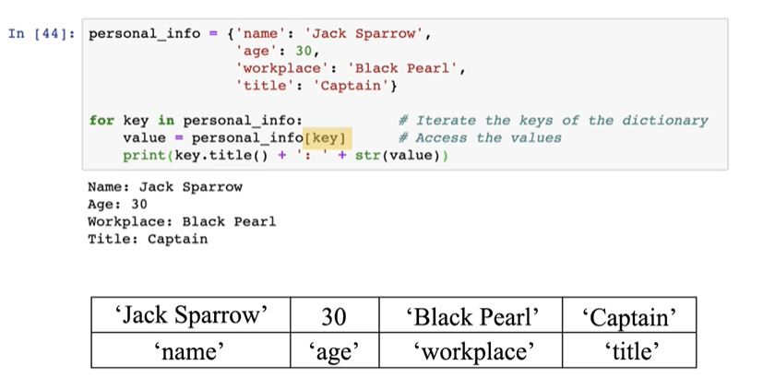
Dictionary
Iterate a Dictionary
0 1 2 3 4 5 6 7 8 9 10 11 12
-13 -12 -11 -10 -9 -8 -7 -6 -5 -4 -3 -2 -1

Slide 105
Roadmap
Introduction
Objects, Variables, and Data Types
Strings
Control Flow: Boolean Type

Slide 106
Control Flow: Boolean Type
The Boolean Type Expressions
Status:
True
or
False
Comparison operators
Operators
Remarks
Example
==
Equal
Not equal
Greater than or equal to Smaller than or equal to Greater than
Smaller than
x == y x != y x >= y x <= y x > y
x < y
!=
>=
<=
>
<

Slide 107
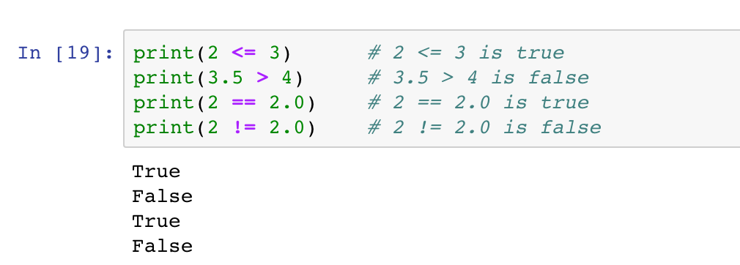
Control Flow: Boolean Type
The Boolean Type Expressions
Status:
True
or
False
Comparison operators

Slide 108
Control Flow: Boolean Type
The Boolean Type Expressions
Status:
True
or
False
Identity operators
Operators
Remarks
Examples
x is y
is
Returns True if both variables are the same object
is not
Returns True if two variables are not the same object
x is not y

Slide 109
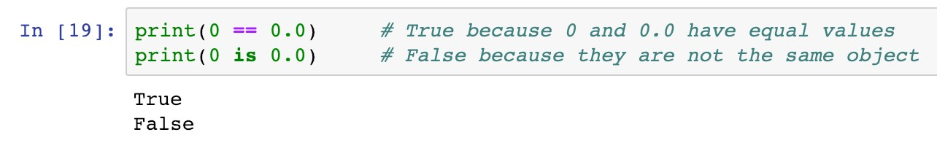
Control Flow: Boolean Type
The Boolean Type Expressions
Status:
True
or
False
Identity operators
Operators
Remarks
Examples
x is y
is
Returns True if both variables are the same object
is not
Returns True if two variables are not the same object
x is not y

Slide 110
Control Flow: Boolean Type
The Boolean Type Expressions
Status:
True
or
False
Membership operators
Operators
Remarks
Examples
x in y
in
Returns True if it finds variable in the specified sequence and False otherwise
not in
Returns False if it finds variable in the specified sequence and True otherwise
x not in y

Slide 111
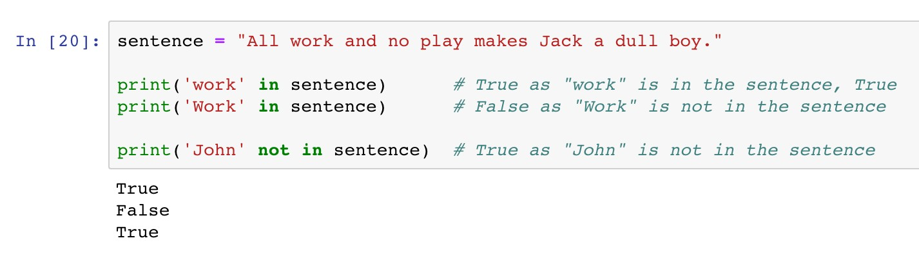
Control Flow: Boolean Type
The Boolean Type Expressions
Status:
True
or
False
Membership operators

Slide 112
Control Flow: Boolean Type
The Boolean Type Expressions
Status:
True
or
False
Logic operators
Operators
Remarks
Examples
x >= 1 and y <= 1
< 1
and
Returns True if
both statements are True
Returns True if either one statements is True
Reverse the result, returns False if the result
or
x > 1 or y
not x == 0
not

Slide 113

Control Flow: Boolean Type
The Boolean Type Expressions
Status:
True
or
False
Logic operators

Slide 114
Control Flow: Boolean Type
The Boolean Type Expressions
Status:
True
or
False
Logic operators
The condition is True if at least one statement is True

Slide 115
Control Flow: Boolean Type
The Boolean Type Expressions
Status:
True
or
False
Logic operators
The condition is True if both statements are True

Slide 116
Roadmap
Introduction
Objects, Variables, and Data Types
Strings
Control Flow: if

Slide 117
Control Flow: from Boolean Type…
Conditional Statements
The
if-elif-else
syntax enables diﬀerent actions according
to the status of given boolean expressions.

Slide 118


Control Flow: if
Conditional Statements
if
<boolean statement 1>:
<code body 1>
<code body 2>
The
if
syntax
if
Keyword
Execute <code body 1> if
<boolean statement 1> is and skip it if otherwise
Indent (a tab or four spaces)
<code body 1> to diﬀerentiate it from <code body 2>
if
False
<boolean statement 1>:
True
<code body 1>
True,
<code body 2>

Slide 119



Control Flow: if
Conditional Statements
The
if
syntax

Slide 120

Control Flow: if
Conditional Statements
The
if
syntax

Slide 121
Control Flow: if
Conditional Statements
The
if
syntax
Do not forget the colon
Keyword

Slide 122


Control Flow: if
Conditional Statements
The
if
syntax
Execute this line if the condition is True
Indentation (a tab or four spaces)

Slide 123
Control Flow: if
Conditional Statements
The
if
syntax
This line is out of the conditional statement

Slide 124
Control Flow: if
Conditional Statements
The
if
syntax
What is the printed message if
is
can_protect_earth
True

Slide 125

Control Flow: if-else
Conditional Statements
if
<boolean statement 1>:
<code body 1>
:
<code body 2>
<code body 3>
False
<boolean statement 1>:
The
if-else
syntax
else
if
else
Keyword and
Execute <code body 1> if
<boolean statement 1> is
Execute <code body 2> if
<boolean statement 1> is
Same indentations for
if
True
True
<code body 1>
else
: <code body 2>
False
else
<code body 3>

Slide 126

Control Flow: if-else
Conditional Statements
The
if-else
syntax

Slide 127

Control Flow: if-else
Conditional Statements
The
if-else
syntax

Slide 128
Control Flow: if-else
Conditional Statements
The
if-else
syntax
Execute this line if the condition is False
Indentation (a tab or four spaces)

Slide 129




Control Flow: if-elif-else
Conditional Statements
if
<boolean statement 1>:
<code body 1>
The
if-elif-else
syntax
elif
: <boolean statement 2>:
<code body 2>
Keyword elif to add more conditions
else
:
<code body 3>
<code body 4>
False
<boolean statement 1>:
if
True
<code body 1>
elif
<boolean statement 2>:
False
True
<code body 2>
else
: <code body 3>
<code body 4>

Slide 130

Control Flow: if
Conditional Statements
Example 4
The price of ticket for Disneyland is $35 for adults, and $16 for senior citizens (60 years old or above). The ticket price for children aged 3 to 12 years old, is $23, and it is free for children under 3 years old. Write a program to determine the ticket price given a visitor’s age.

Slide 131





Control Flow: if
Conditional Statements
if
age < 3:
False
True
price = 0
elif
age <= 12:
False
True
price = 23
elif
age < 60:
False
True
price = 35
else
: price = 16
print(price)

Slide 132

Control Flow: if
Conditional Statements
Example 4
The price of ticket for Disneyland is $35 for adults, and $16 for senior citizens (60 years old or above). The ticket price for children aged 3 to 12 years old, is $23, and it is free for children under 3 years old. Write a program to determine the ticket price given a visitor’s age.

Slide 133


Control Flow: if
Conditional Statements
Example 5
A news boy ordered 550 newspapers to sell. Each piece of newspaper costs 10 cents and can be sold at 60 cents. Write a program to calculate the total profit, given a fixed demand.

Slide 134

Control Flow: if
Conditional Statements
Example 5
A news boy ordered 550 newspapers to sell. Each piece of newspaper costs 10 cents and can be sold at 60 cents. Write a program to calculate the total profit, given a fixed demand.

Slide 135

Control Flow: if
Conditional Statements
Example 5
A news boy ordered 550 newspapers to sell. Each piece of newspaper costs 10 cents and can be sold at 60 cents. Write a program to calculate the total profit, given a fixed demand.
Coding Style
Zen of Python:
Readability counts

Slide 136


Control Flow: if
Conditional Statements
Question
What is the output message of the following code?
5
True
False
1

Slide 137


Control Flow: if
Conditional Statements
The nested if-elif-else structure

Slide 138

Control Flow: if
Conditional Statements
The nested if-elif-else structure

Slide 139


Control Flow: if
Conditional Statements
The nested if-elif-else structure
Leftover only occur in the case that demand is lesser than order

Slide 140
Roadmap
Introduction
Objects, Variables, and Data Types
Strings
Control Flow: while

Slide 141


Control Flow: while
Iterations and loops
while
<boolean statement>:
<code body to be repeated>
<other code>
The
while
loop
while
Keyword
Check the status of
<boolean statement> in each iteration
Repeatedly Execute <code to be repeated> if <boolean statement> is
Same indentations for
<code to be repeated>
while
False
<boolean statement>:
True
<code to be repeated>
True
<other code>

Slide 142


Control Flow: while
Iterations and loops
The
while
loop

Slide 143



Control Flow: while
Iterations and loops
The
while
loop
Example 1
In the movie Dr. Strange (2016), Steven Strange beat the supervillain "Dormammu" by keeping annoying him until he was extremely bored and frustrated. Write a program to act like Dr. Strange. The "time" loop can only be broken when you type in "I quit" or "You win".
False
<boolean statement>:
True
<code to be repeated>
while
<other code>

Slide 144


Control Flow: while
Iterations and loops
The
while
loop
Example 1
In the movie Dr. Strange (2016), Steven Strange beat the supervillain "Dormammu" by keeping annoying him until he was extremely bored and frustrated. Write a program to act like Dr. Strange. The "time" loop can only be broken when you type in "I quit" or "You win".
False
Dormammu not quit:
True
I’ve come to bargain What does Dormammu say?
Movie ends
while

Slide 145

Control Flow: while
Iterations and loops
The
while
loop
Example 1
In the movie Dr. Strange (2016), Steven Strange beat the supervillain "Dormammu" by keeping annoying him until he was extremely bored and frustrated. Write a program to act like Dr. Strange. The "time" loop can only be broken when you type in "I quit" or "You win".

Slide 146


Control Flow: while
Iterations and loops
while
False
Dormammu not quit:
The
while
loop
True
I’ve come to bargain What does Dormammu say?
Movie ends
Check the condition in each iteration
Indentation
Loop body

Slide 147
Control Flow: while
Iterations and loops
while
False
Dormammu not quit:
The
while
loop
True
I’ve come to bargain What does Dormammu say?
Movie ends
An inner conditional statement to check if Dormammu quits

Slide 148
Control Flow: while
Iterations and loops
while
False
Dormammu not quit:
The
while
loop
True
I’ve come to bargain What does Dormammu say?
Movie ends
Extra Indentation
Extra Indentation
Execute if the boolean condition is True
Execute if the boolean condition is False

Slide 149
Control Flow: while
Iterations and loops
while
False
Dormammu not quit:
The
while
loop
True
I’ve come to bargain What does Dormammu say?
Movie ends
True
Change the boolean status to stop the loop

Slide 150

Control Flow: while
Iterations and loops
The
while
loop
Example 1
In the movie Dr. Strange (2016), Steven Strange beat the supervillain "Dormammu" by keeping annoying him until he was extremely bored and frustrated. Write a program to act like Dr. Strange. The "time" loop can only be broken when you type in "I quit" or "You win".

Slide 151


Control Flow: while
Iterations and loops
while
True:
The
while
loop
True
I’ve come to bargain
if Dormammu says “quit” ?
True
break
Movie ends
Always True
Indentation
Loop body

Slide 152
Control Flow: while
Iterations and loops
while
True:
The
while
loop
True
I’ve come to bargain
if Dormammu says “quit” ?
True
break
Movie ends
Stop the loop immediately

Slide 153
Control Flow: while
Iterations and loops
The
while
loop
while
Keyword
Indentations for the code block to be repeated
Stoping criterion
Indefinite iterations (unknown number of iterations)

Slide 154
Roadmap
Introduction
Objects, Variables, and Data Types
Strings
Control Flow: for

Slide 155


Control Flow: for
Iterations and loops
The
for
loop
for
<item> in <sequence>:
<code body to be repeated>
<other code>
for
in
Keywords and
In each iteration, <item> takes one value from
<sequence>
The number of iterations is the number of values in <sequence>
Same indentations for
<code to be repeated>
for
<item>
in
<sequence>:
<item> takes one value
<code to be repeated>
Loop stops
<other code>

Slide 156

Control Flow: for
Iterations and loops
The
for
loop
Example 2 Cheerleader chant
for
<item>
in
<sequence>:
<item> takes one value
<code to be repeated>
Loop stops
<other code>

Slide 157

Control Flow: for
Iterations and loops
The
for
loop
Example 2 Cheerleader chant
for
in
letter name:
letter takes each letter
Shout out each letter
Loop stops
Go! Go!

Slide 158




Control Flow: for
Iterations and loops
for
in
letter name:
letter takes each letter
Shout out each letter
The
for
loop
Loop stops
Take each letter from name in each iteration
Go! Go!
Indentation
Loop body

Slide 159
Control Flow: for
Iterations and loops
The
for
loop
name
J | a | c | k
Take each letter from name in each iteration
Indentation
Loop body

Slide 160
Control Flow: for
Iterations and loops
The
for
loop
name
J | a | c | k
1st iteration
letter
Take each letter from
name in each iteration
Indentation
Loop body

Slide 161
Control Flow: for
Iterations and loops
The
for
loop
name
J | a | c | k
2nd iteration
letter
Take each letter from
name in each iteration
Indentation
Loop body

Slide 162
Control Flow: for
Iterations and loops
The
for
loop
name
J | a | c | k
3rd iteration
letter
Take each letter from
name in each iteration
Indentation
Loop body

Slide 163
Control Flow: for
Iterations and loops
The
for
loop
name
J | a | c | k
4th iteration
letter
Take each letter from
name in each iteration
Indentation
Loop body

Slide 164
Control Flow: for
Iterations and loops
The
for
loop
How to skip whitespaces?

Slide 165

Control Flow: for
Iterations and loops
The
for
loop
Take each letter from name in each iteration
Indentation
Loop body

Slide 166
Control Flow: for
Iterations and loops
The
for
loop
If letter is a whitespace
Skip the subsequent code and continue to the next iteration
Extra Indentation

Slide 167
Control Flow: for
Iterations and loops
‣
break
and
continue

Slide 168

Control Flow: for
Iterations and loops
Example 3 Difference between
‣
break
and
continue
break
and
continue

Slide 169
Control Flow: for
Iterations and loops
a | b | c | d | e | f | g
a_string
‣
break
and
continue

Slide 170
Control Flow: for
Iterations and loops
a | b | c | d | e | f | g
a_string
‣
break
and
continue
new_string

Slide 171
Control Flow: for
Iterations and loops
letter
 | b | c | d | e | f | g
a_string
a
‣
1st iteration
break
and
continue
new_string
a

Slide 172
Control Flow: for
Iterations and loops
letter
a |  | c | d | e | f | g
a_string
b
‣
2nd iteration
break
and
continue
new_string
a
b

Slide 173
Control Flow: for
Iterations and loops
letter
a | b |  | d | e | f | g
a_string
c
‣
break
and
continue
3rd iteration
a b
new_string
break

Slide 174
Control Flow: for
Iterations and loops
letter
a | b |  | d | e | f | g
a_string
c
‣
break
and
continue
3rd iteration
a b
new_string
break

Slide 175
Control Flow: for
Iterations and loops
a | b | c | d | e | f | g
a_string
‣
break
and
continue
new_string

Slide 176
Control Flow: for
Iterations and loops
letter
 | b | c | d | e | f | g
a_string
a
‣
1st iteration
break
and
continue
new_string
a

Slide 177
Control Flow: for
Iterations and loops
letter
a |  | c | d | e | f | g
a_string
b
‣
2nd iteration
break
and
continue
new_string
a
b

Slide 178
Control Flow: for
Iterations and loops
letter
a | b |  | d | e | f | g
a_string
c
‣
break
and
continue
3rd iteration
a b
new_string
continue

Slide 179
Control Flow: for
Iterations and loops
letter
a | b | c |  | e | f | g
a_string
d
‣
4th iteration
break
and
continue
new_string
a | b | d

Slide 180
Control Flow: for
Iterations and loops
letter
a | b | c | d |  | f | g
a_string
e
‣
5th iteration
break
and
continue
new_string
a | b | d | e

Slide 181
Control Flow: for
Iterations and loops
letter
a | b | c | d | e |  | g
a_string
f
‣
6th iteration
break
and
continue
new_string
a | b | d | e | f

Slide 182
Control Flow: for
Iterations and loops
letter
a | b | c | d | e | f
a_string
g
‣
7th iteration
break
and
continue
new_string
a | b | d | e | f | g

Slide 183
Control Flow: for
Iterations and loops
letter
a | b | c | d | e | f
a_string
g
‣
7th iteration
break
and
continue
new_string
a | b | d | e | f | g

Slide 184


Control Flow: for
Iterations and loops
Question
What is the output message of the following code?
ab
abc
abcd
abdefg

Slide 185
Control Flow: for
Iterations and loops
Comparison between
while
for
loop
loop
Definite iteration
A counter is updated through the loop
loop and
while
loop
for
Indefinite iteration
A counter can be defined and manually updated
Break the loop by
break
Skip the code by
continue

